Slide 1
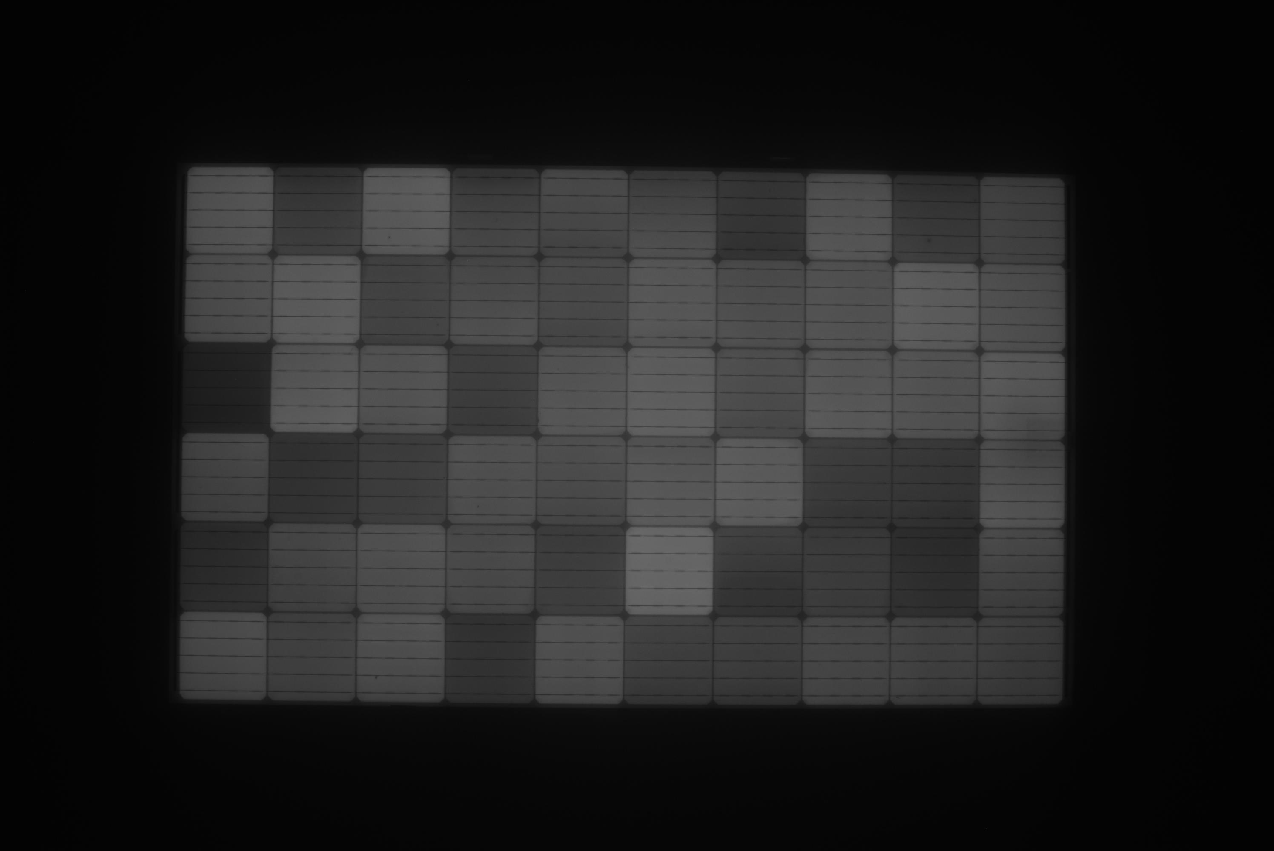
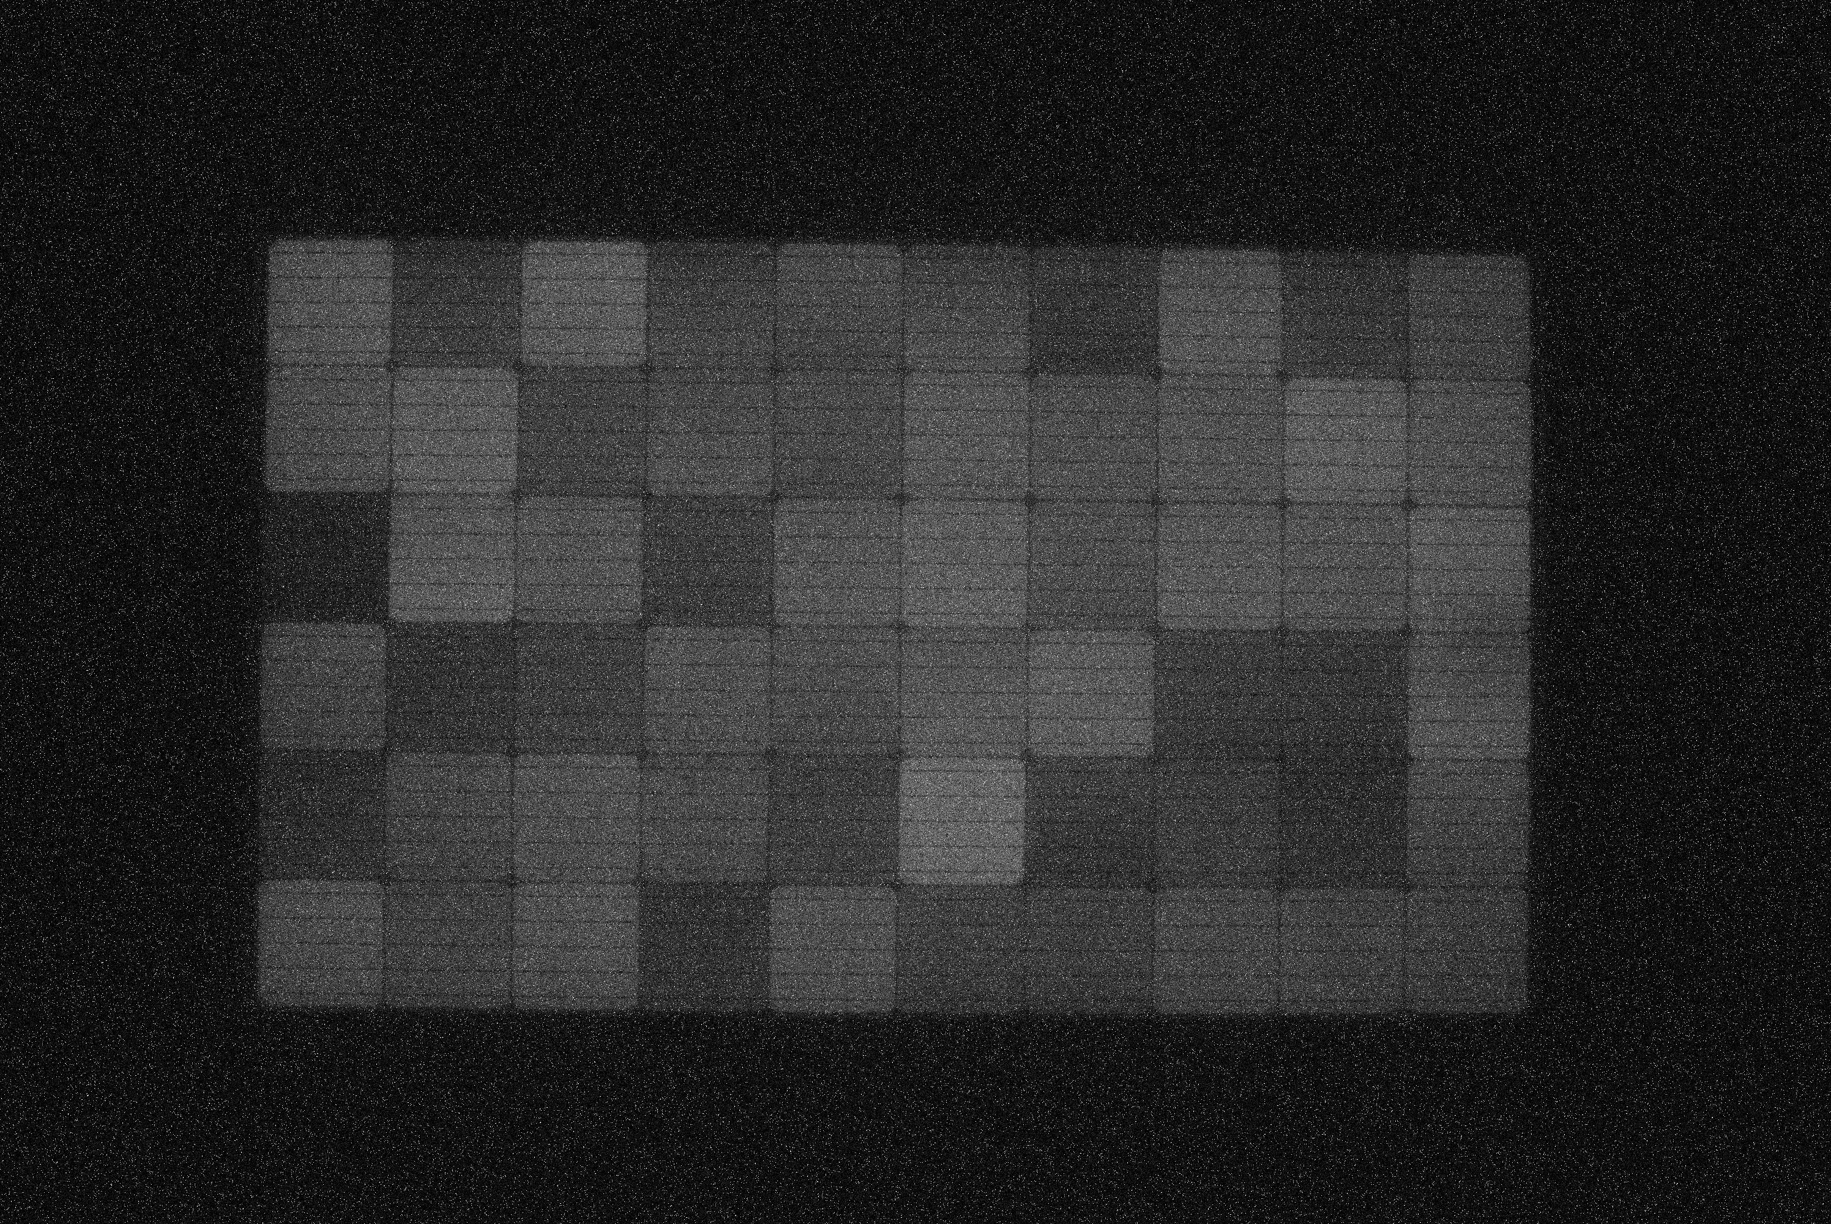
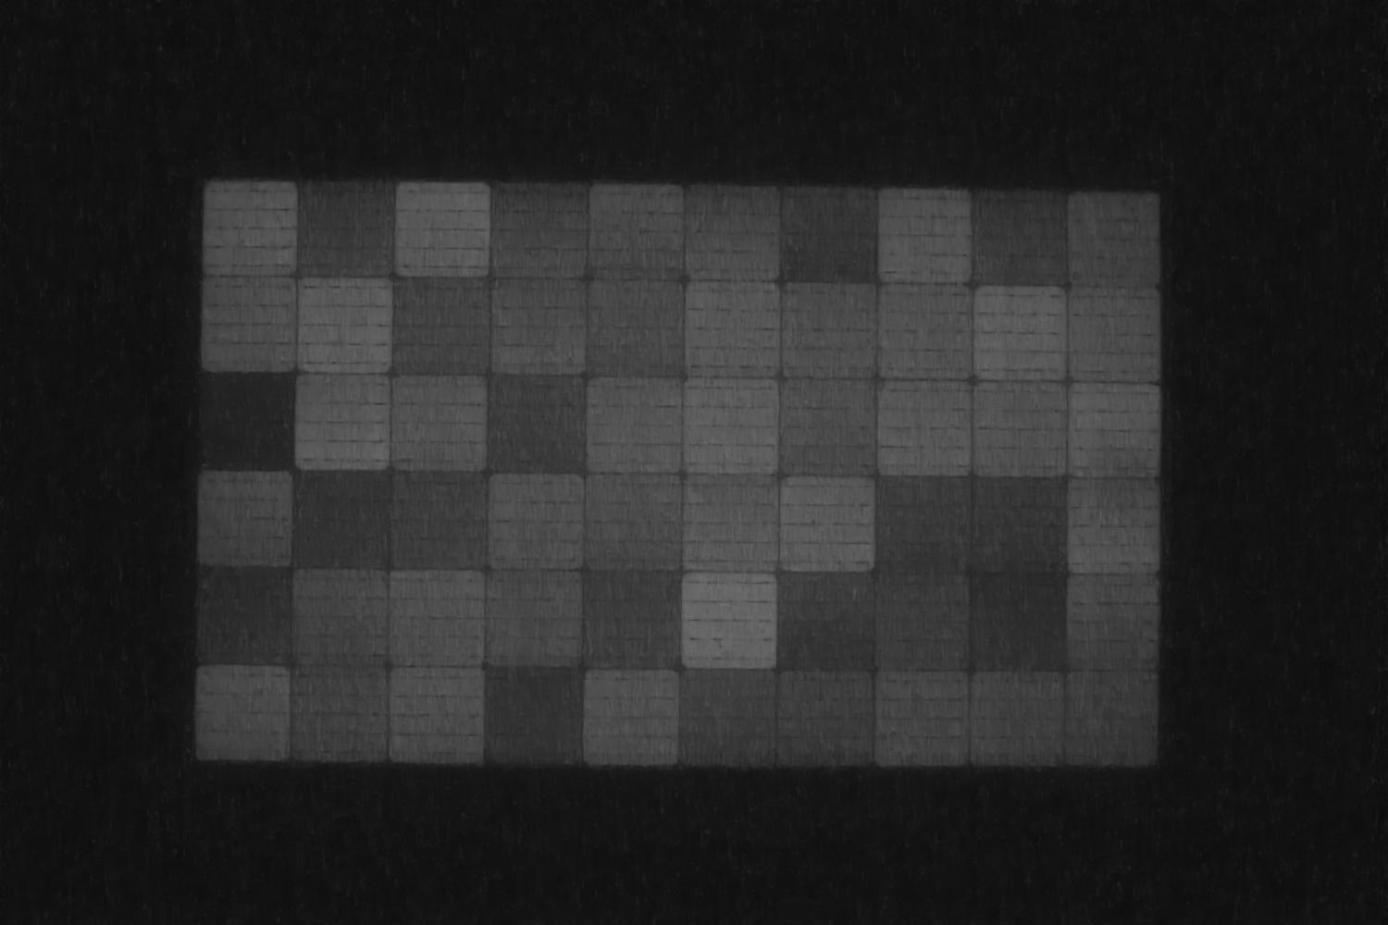


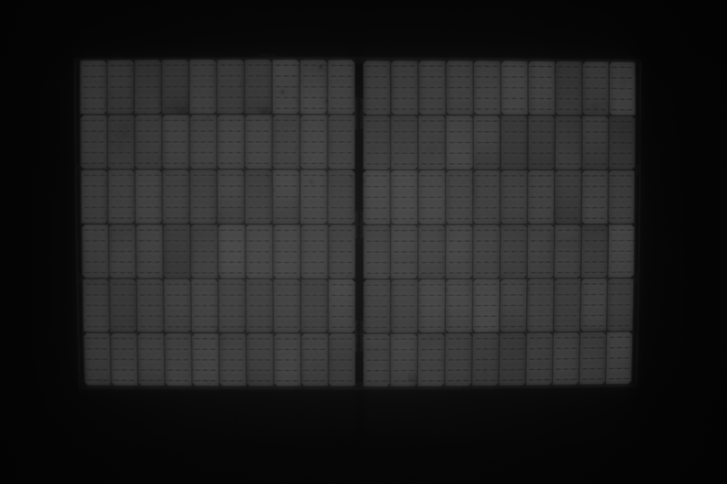
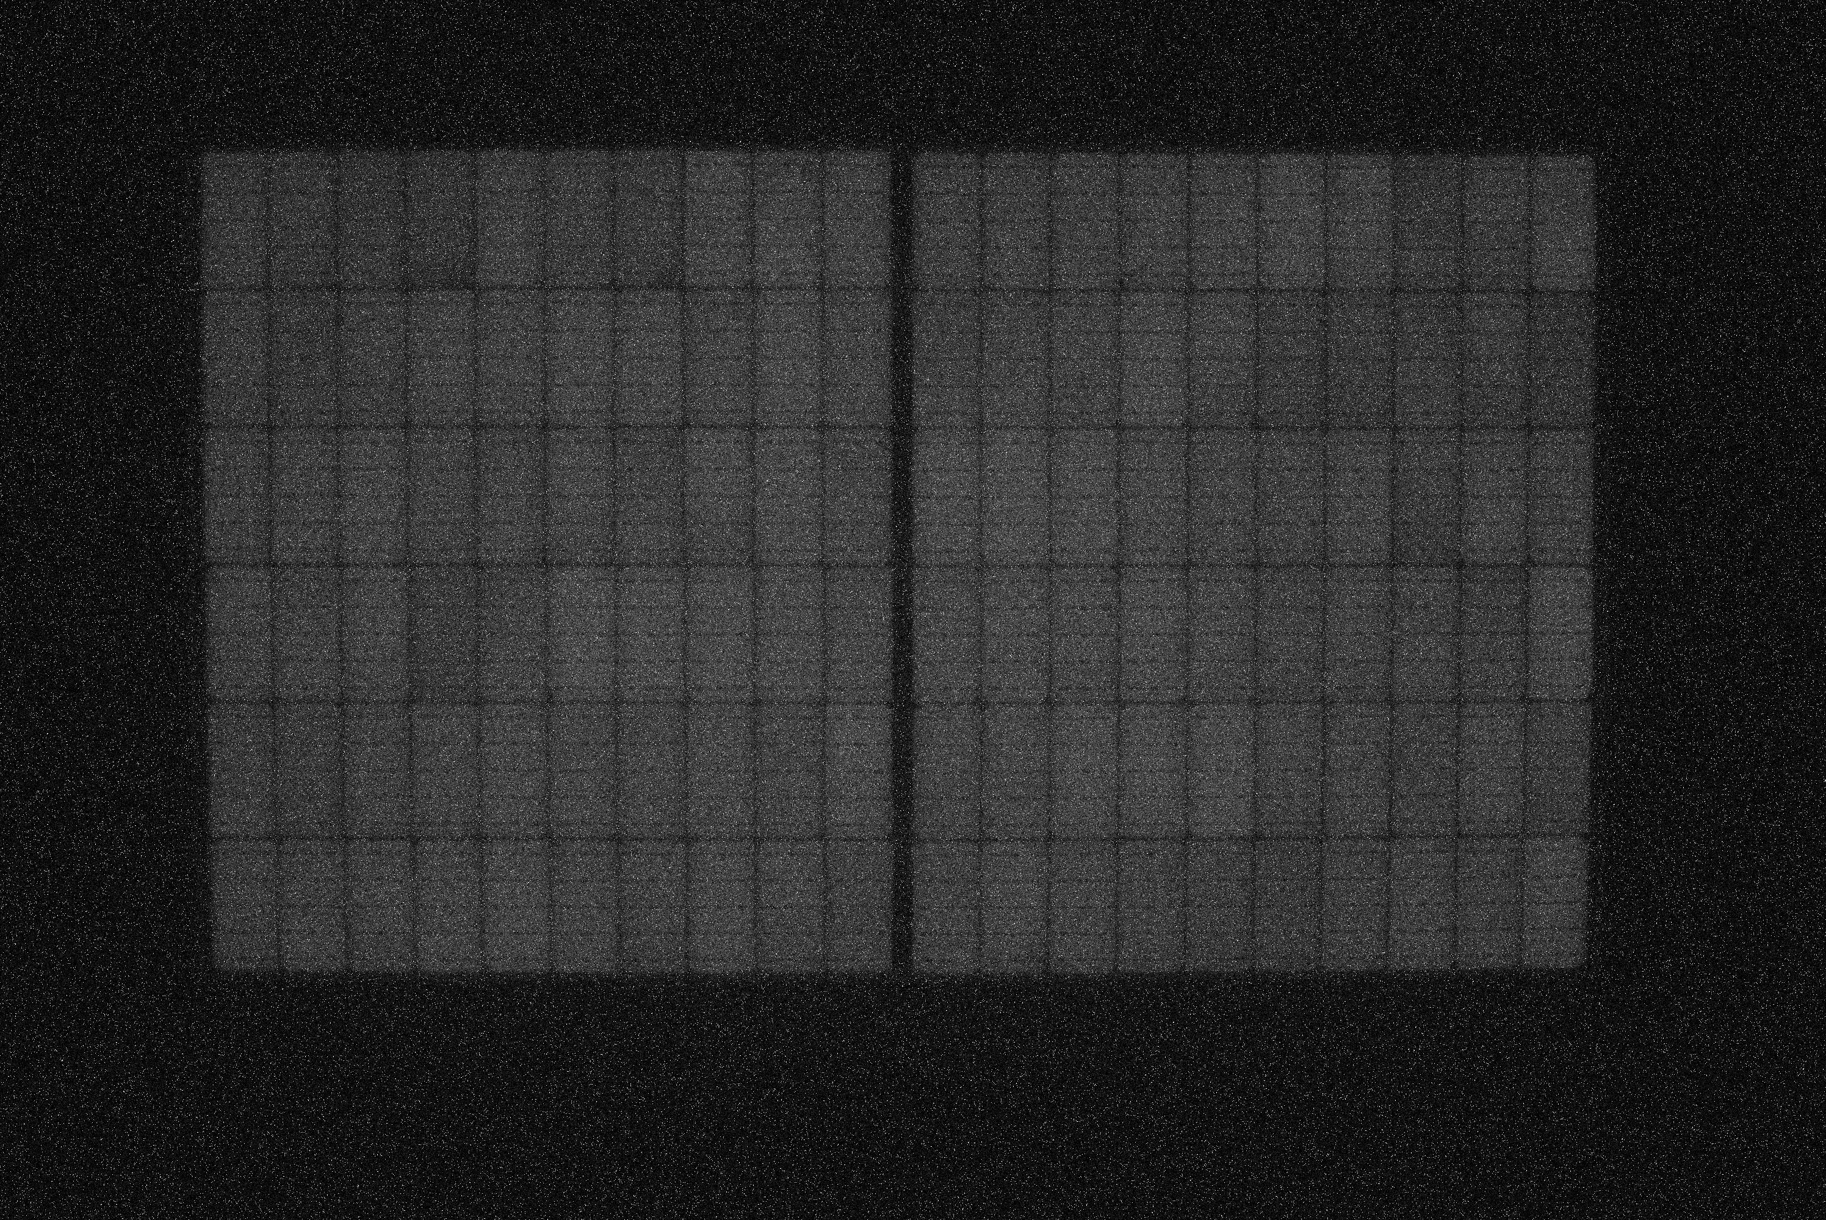
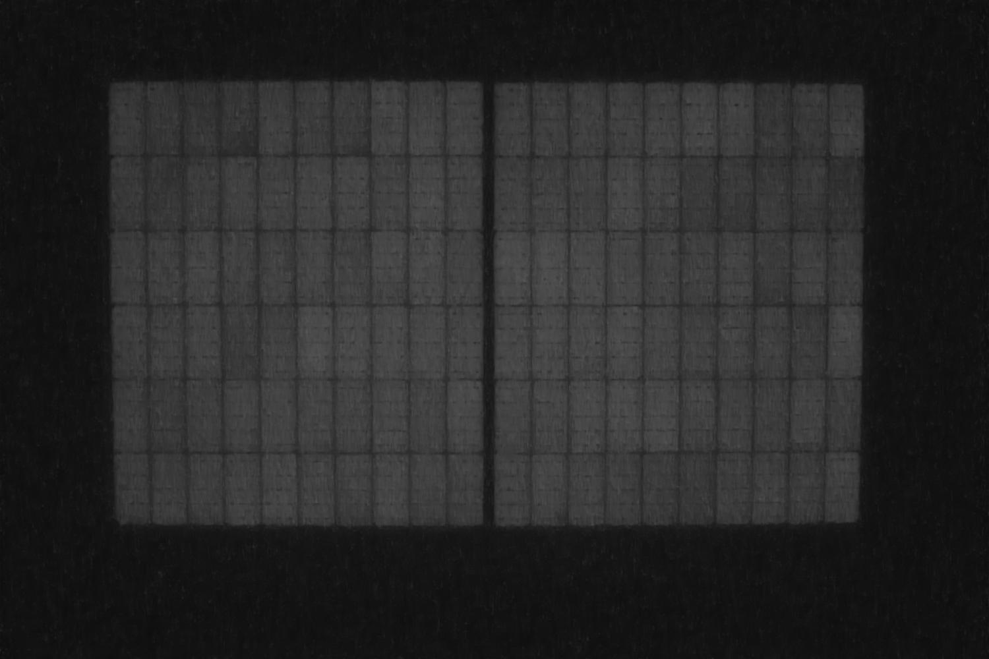


(a)
(b)
(c)
(d)
(e)
10 cm
(f)
(g)
(h)
(i)
(j)
SSIM:0.005
PSNR:16.46
SSIM:0.576
PSNR:28.82
SSIM:0.774
PSNR:31.37
SSIM:0.841
PSNR:34.33
10 cm
(k)
(l)
(m)
(n)
(o)
10 cm
(p)
(q)
(r)
(s)
(t)
SSIM:0.011
PSNR:16.45
SSIM:0.552
PSNR:28.43
SSIM:0.810
PSNR:32.08
SSIM:0.845
PSNR:34.45
10 cm
Original
Noisy
Cell denoised [16]
BM3D
This study

